Slide 1
ePharmacy
DBMS Lab Project
Group Members
ID | Name
171-15-8596 | Rashidul Hasan Hridoy
171-15-8597 | Mudakherunnessa Monisha
133-15-3005 | Nazia Farha

Slide 2
Introduction

Slide 3
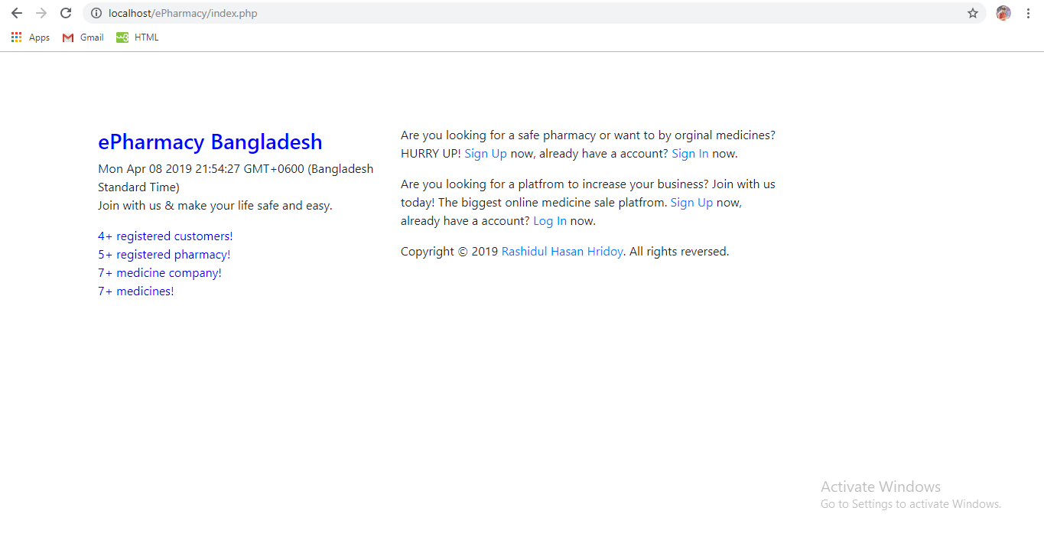
ePharmacy is a web based project, developed by using HTML, CSS, Bootstrap, PHP, JavaScript.
It has three main parts and they are admin, pharmacy, customer.
A pharmacy owner can add his or her pharmacy in this system and easily sale his products.
Customers can easily create a order by choosing nearest pharmacy and they can also save the order for future submit.
Pharmacy and customer owner both can give review one another.
Home page of ePharmacy

Slide 4
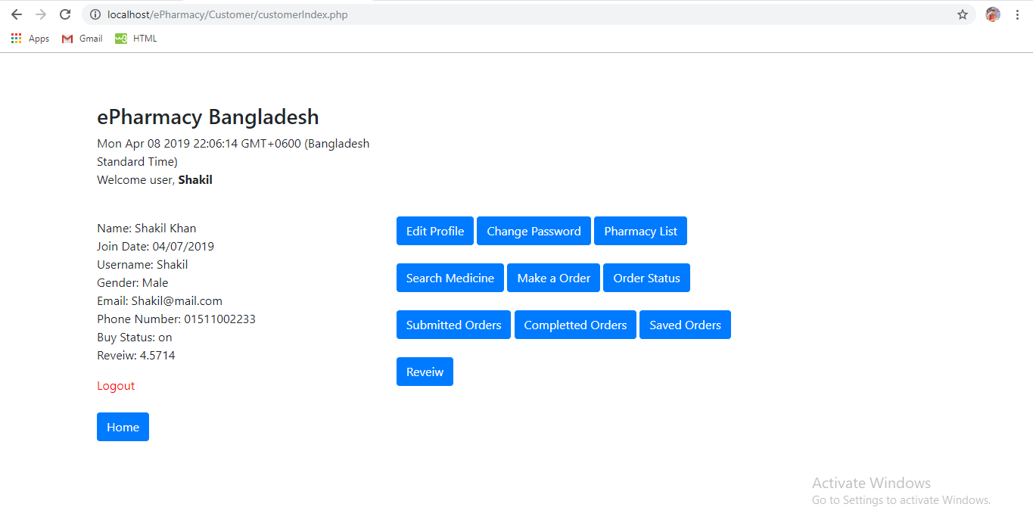
When a new pharmacy user want to create a new account, he or she need to fill up sign form first and then submit it. Then a pharmacy new account approval request go to a admin, if admin accept it, then he or she can use it.
A new admin account need to be approved by another admin.
Based on review an admin can deactivated a pharmacy or customer account, then a pharmacy can’t buy his or her products and a customer can’t create orders.
Customer Home Page

Slide 5
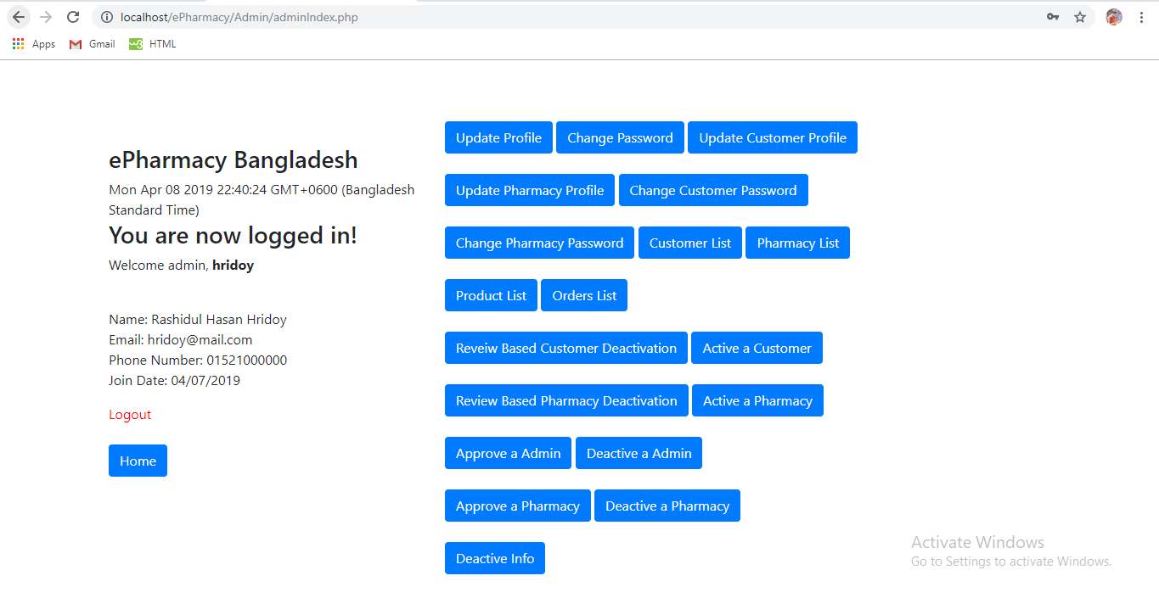
If a pharmacy can’t maintain policy, then admin can temporary locked his or her account, then he or she can’t log in.
An admin can deactivated another admin account if need.
Customer can check their order status easily, there are three types of status. They are pending, ready and received.
Admin can fully control this system using admin features.
Admin Home Page

Slide 6
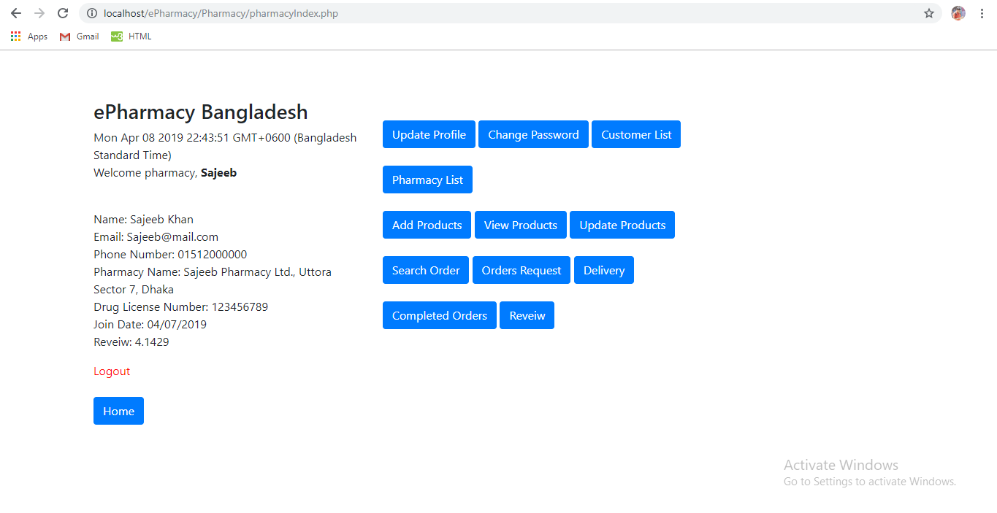
If one or more taps open on browser, if user log out from one page, then his or her account automatically logout from other tabs also.
Our project will help people to easily safe medicine and they don’t need to be worry.
Home Page of Pharmacy

Slide 7
Software Requirements

Slide 8



Chrome Browser, Version 73.0.3683.86 or newer.
Link: https://www.google.com/chrome
Firefox Browser, Version 66.0.2 or newer.
Link: https://www.mozilla.org/en-US/firefox/new
You can use any one of these.
XAMMP Server, version 7.3.3 or newer.
Link: https://www.apachefriends.org/download.html

Slide 9
How to make order?

Slide 10

Select nearest pharmacy >
Add product to cart >
Edit / Delete Product
Confirm Order –
Discard Order –
Save Order
Easy order system will make your life so easy!

Slide 11
Check Order Status

Slide 12
Pending -
means your order is submitted.
Ready -
means you can collect products.
Received -
means you can received products.
Relax! You will get time to time update of your orders.

Slide 13
How to complete an order?

Slide 14
[status : pending]
Orders Request
See new orders and ready it to deliver.
[status : ready]
Delivery
Deliver order to customer.
[status : received]

Slide 15
Security Part

Slide 16
A new admin or pharmacy account need to be approved by a customer.
Auto log out from all tabs, if users log out from any tab.
MD5 is used to encrypt password.

Slide 17
Control Part

Slide 18
Admin can deactivated a customer or pharmacy account, based on review.
Admin can deactivated another admin account if needed.

Slide 19
Review

Slide 20

Both pharmacy authority and customer can give review each other after completed a order.
It helps to maintain a good relation between them.

Slide 21
Thanks!

